Slide 1


Correlation of Geomagnetic Storms with Infrasound Observation Data from International Monitoring System Stations Located in South America
Arthur S. de Macêdo, Elder Yokoyama, Lucas V. Barros, Darlan P. Fontenele and Juraci M. de Carvalho
University of Brasília - UnB
The Earth is hit by solar storms, and its magnetic field protects against radiation. Ions from these storms create auroras in polar regions: the aurora borealis in the north and the aurora australis in the south. The movement of these ions generates bow waves that can be detected by acoustic sensors.
The study focused on the solar storm of April 23, 2023, chosen for its Kp index value. Ten IMS stations were selected to ensure extensive coverage in South America. Additionally, three stations in the northern hemisphere were chosen to enable temporal series comparison.
In the study, we obtained frequency, velocity, and date/time-related results correlated with the selected auroras. These results provide valuable information about the characteristics of these specific auroras. By analyzing this data, we can gain a deeper understanding of the patterns and behaviors of the auroras at a infrasound time series
During the geomagnetic storms coinciding with aurora activity, stations detected signals. The number of detections correlates with sensor array size and proximity to the aurora zone. In this study, two Southern Hemisphere stations (I01AR and I50GB) and three Northern Hemisphere stations (I37NO, I42PT, and I56US) detected the event..
Please do not use this space, a QR code will be automatically overlayed
P1.1-489

Slide 2
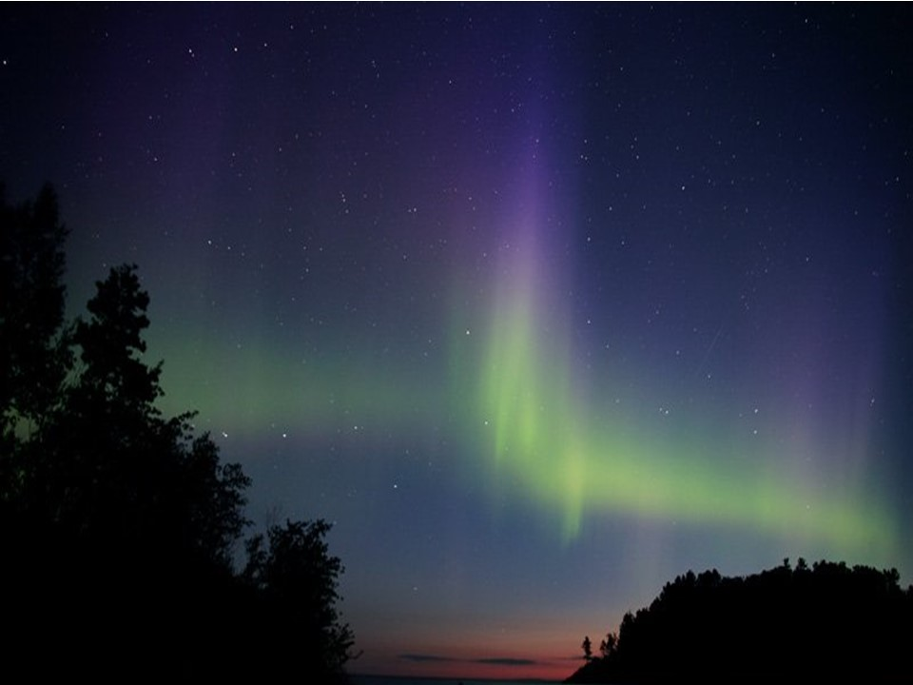
INTRODUCTION
The Earth is sporadically bombarded by solar storms, and its magnetic field acts as a protective shield, deflecting the radiation (Dal Poz, 2006).
It is known that ions propagated by these storms enter in polar regions, and they are responsible for the generation of auroras (Fig. 1), as follows:
(i) the aurora borealis, formed in the northern hemisphere; and
(ii) the aurora australis, formed in the southern hemisphere.
The movement of these ions in the atmosphere generates bow waves (Wilson, 2005), which can be detected by acoustic sensors.
Please do not use this space, a QR code will be automatically overlayed
Fig. 1 – Auroral Phenomena (NOAA, 2023)
P1.1-489

Slide 3
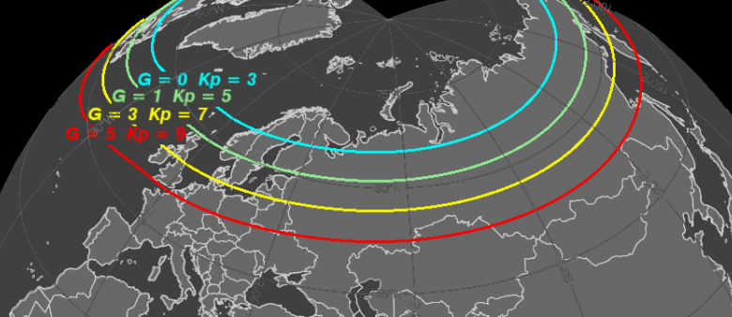
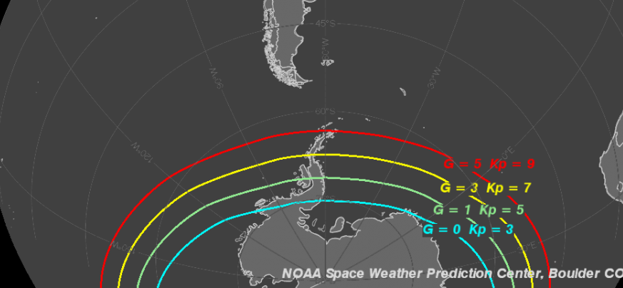
OBJECTIVES
This study aims to correlate the occurrence of Auroras with signals detected at IMS infrasound stations, mainly located at South America.
In the Fig. 2 is shown how far the auroras can be observed in both hemisphere.
However, according to Le Pichon et al., (2010) and Wilson (2005) the auroras, generated by geomagnetic storms, can be detected by infrasound stations located outside of the auroras range observation, i.e., outside the auroras visual effect.
This phenomena was studied by Wilson et al (2005), using infrasound microphones array located at Fairbanks - Alaska.
Please do not use this space, a QR code will be automatically overlayed
Fig. 2 - Map displaying the widest range of aurora observations based on the Kp indices of geomagnetic storms (NOAA, 2023).
P1.1-489

Slide 4
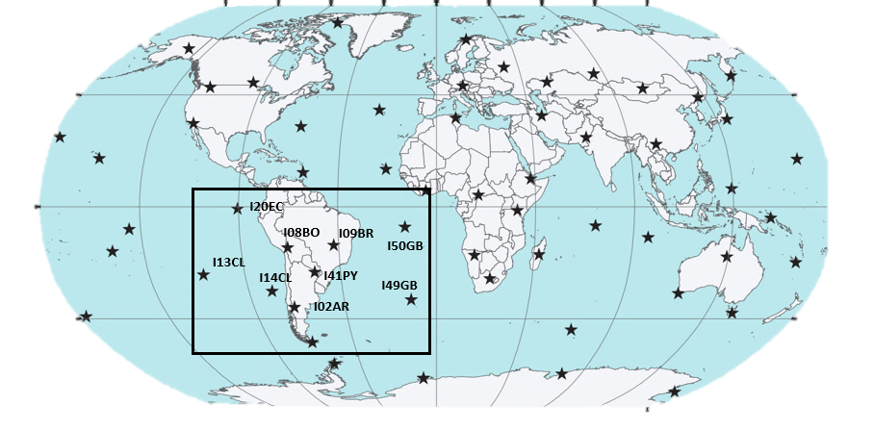
METHODS/DATA
The solar storm on April 23, 2023, was chosen for this study due to its high Planetary K-index of 8 (on a scale of 1 to 9). The data for the study was obtained from ISIG (http://isgi.unistra.fr).
In order to provide good coverage of the study in South America, ten IMS infrasound stations were selected (Fig. 3).
Additionally, three stations in the northern hemisphere (I37NO, I42PT and I56US) were chosen for the purpose of comparing the temporal series.
The data originated from details regarding the sighting of an aurora, which was detected by NOAA on April 23, 2023.
I58US
I37NO
I42PT
I01AR
I02AR
Please do not use this space, a QR code will be automatically overlayed
P1.1-489

Slide 5
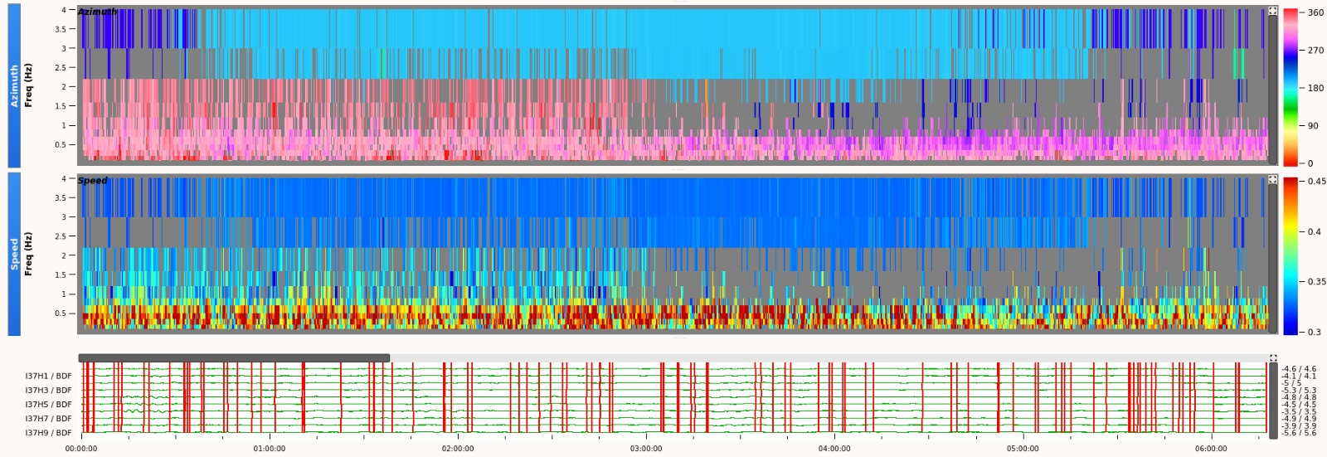
RESULTS
For the purpose of signal comparison, stations located in the Northern Hemisphere (I37NO) and the Southern Hemisphere (I01AR and I50GB) are included. Several detections can be seen in the record of Fig. 4. The families associated to this detections show the following: predominant frequencies 2.5 - 4Hz; azimuth 190º; and speed of the acoustic signal 330 m/s.
Please do not use this space, a QR code will be automatically overlayed
Fig. 4 – Record of an aurora detected by I37NO (Norway) on April 23, 2023. In the Figure is shown 6 hours of data, from 00h 00 to 06h 00.
P1.1-489

Slide 6
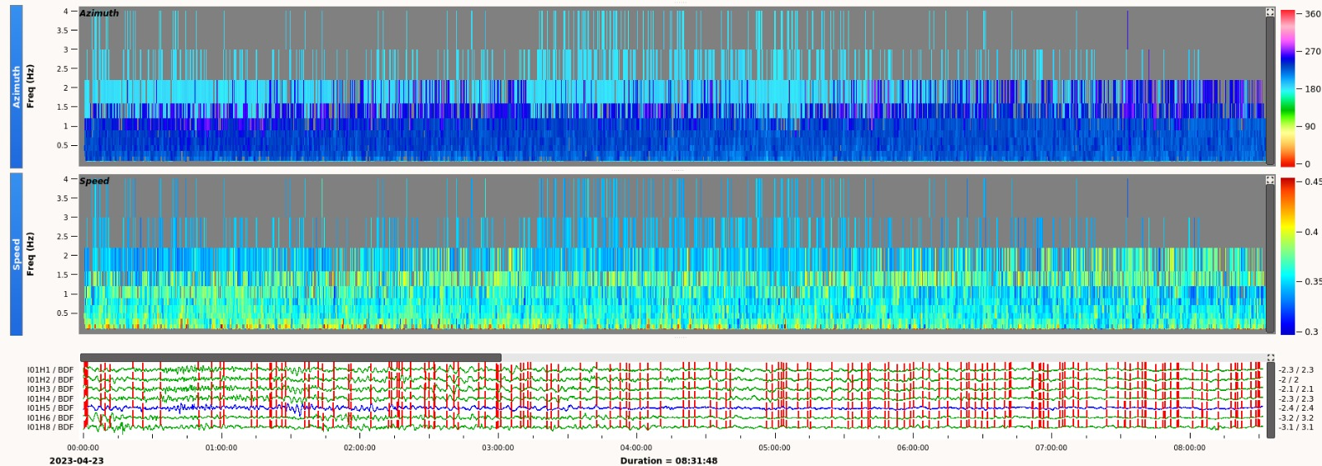
RESULTS
The record from I01AR is displayed in Fig. 5 show multiple detections. These detections exhibit the following characteristics: dominant frequencies ranging from 1.9 to 4 Hz, azimuth of 180º, and a speed of acoustic signal 340 m/s.
Please do not use this space, a QR code will be automatically overlayed
Fig. 5 – Record of an aurora detected by I01AR (Argentina) on April 23, 2023. In the Figure is showing 8 hours of data, from 00h 00 to 08h 00
P1.1-489

Slide 7
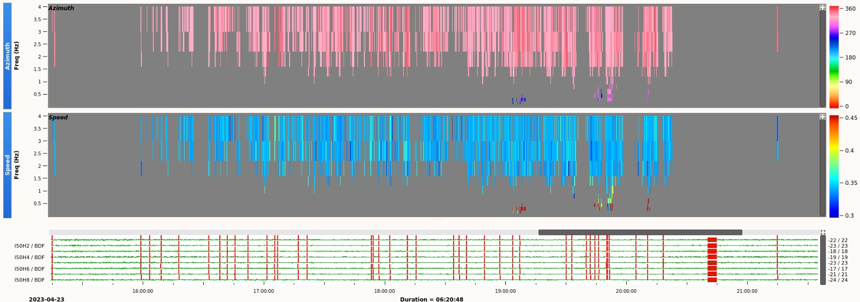
RESULTS
The record of I50GB is depicted in Fig. 6 reveals numerous detections, demonstrating the following characteristics: dominant frequencies 2.3 to 4 Hz, azimuth of 330º, and a speed of acoustic signal 340 m/s.
Please do not use this space, a QR code will be automatically overlayed
Fig. 6 – Record of an aurora detected by I50GB (Ascension Island) on April 23, 2023. In the Figure is showing 6 hours of data, from 15h 00 to 20h 00
P1.1-489

Slide 8
RESULTS
The stations that detected the event in this study are summarized in Table 1 below. It provides an overview of the observed parameters in IMS infrasound stations located in both the Southern Hemisphere (SH) and Northern Hemisphere (NH).
Table 1 – Stations that detected the events and their main parameters: frequency, azimuth, velocity of the acoustic wave, event duration, and number of array elements.
 |  | I01AR (SH) |  | I37NO (NH) |  | I41PT (NH) |  | I50GB (SH) |  | I56US (NH)
Frequency Range (Hz) |  | 1.9 - 4 |  | 2.5 - 4 |  | 1.5 - 4 |  | 2.3 - 4 |  | 1.4 - 4
Back Azimuth (º) |  | 180 |  | 190 |  | 1 |  | 330 |  | 200
Velocity of acoustic signal (m/s) |  | 340 |  | 330 |  | 340 |  | 340 |  | 340
Duration (hours) |  | 6 |  | 6 |  | 3 |  | 6 |  | 6
Number Of Array Elements |  | 8 |  | 10 |  | 7 |  | 8 |  | 4
Please do not use this space, a QR code will be automatically overlayed
P1.1-489

Slide 9
CONCLUSIONS
During the specific date and time of geomagnetic storms that generate auroras, the stations detected signals consistent with aurora activity.
Out of the ten selected stations in the Southern Hemisphere for this study, only two stations (I01AR and I50GB) detected the event, while all three stations (I37NO, I42PT and I56US) from the Northern Hemisphere detected the event.
It is noticeable that the number of detections of signals generated during geomagnetic storms increases proportionally with the number of sensors in a array and the proximity to the aurora zone occurrence.
Please do not use this space, a QR code will be automatically overlayed
P1.1-489

Slide 10
REFERENCES
A. LE PICHON et al. (eds.), Infrasound Monitoring for Atmospheric Studies, DOI 10.1007/978-1-4020-9508-5_6, © Springer Science+Business Media B.V. 2010.
DAL POZ, WILLIAM RODRIGO; DE OLIVEIRA CAMARGO, PAULO. Conseqüências de uma tempestade geomagnética no posicionamento relativo com receptores GPS de simples freqüência. Boletim de Ciências Geodésicas, v. 12, n. 2, p. 275-294, 2006.
NERI, BRANDOW LEE. DETECÇÃO E INTERPRETAÇÃO DE SINAIS DE INFRASSOM COM A ESTAÇÃO INFRASSÔNICA DE BRASÍLIA – I09BR. 2019. (Graduação em Geofísica) - Universidade de Brasília, [S. l.], 2019.
NOOA. AURORA - 30 MINUTE FORECAST. [S. l.], 7 jun. 2023. Disponível em: https://www.swpc.noaa.gov/products/aurora-30-minute-forecast. Acesso em: 7 jun. 2023.
NOOA. TIPS ON VIEWING THE AURORA. [S. l.], 7 jun. 2023. Disponível em: https://www.swpc.noaa.gov/content/tips-viewing-aurora. Acesso em: 7 jun. 2023.
WILSON, Charles R.; OLSON, John V.; STENBAEK‐NIELSEN, Hans C. High trace‐velocity infrasound from pulsating auroras at Fairbanks, Alaska. Geophysical research letters, v. 32, n. 14, 2005.
Wilson, Charles R. Infrasound from auroral electrojet motions at I53US. InfraMatics, v. 10, p. 1-13, 2005.
Please do not use this space, a QR code will be automatically overlayed
P1.1-489

